Slide 1

Cayenne mydevices.com

Slide 2
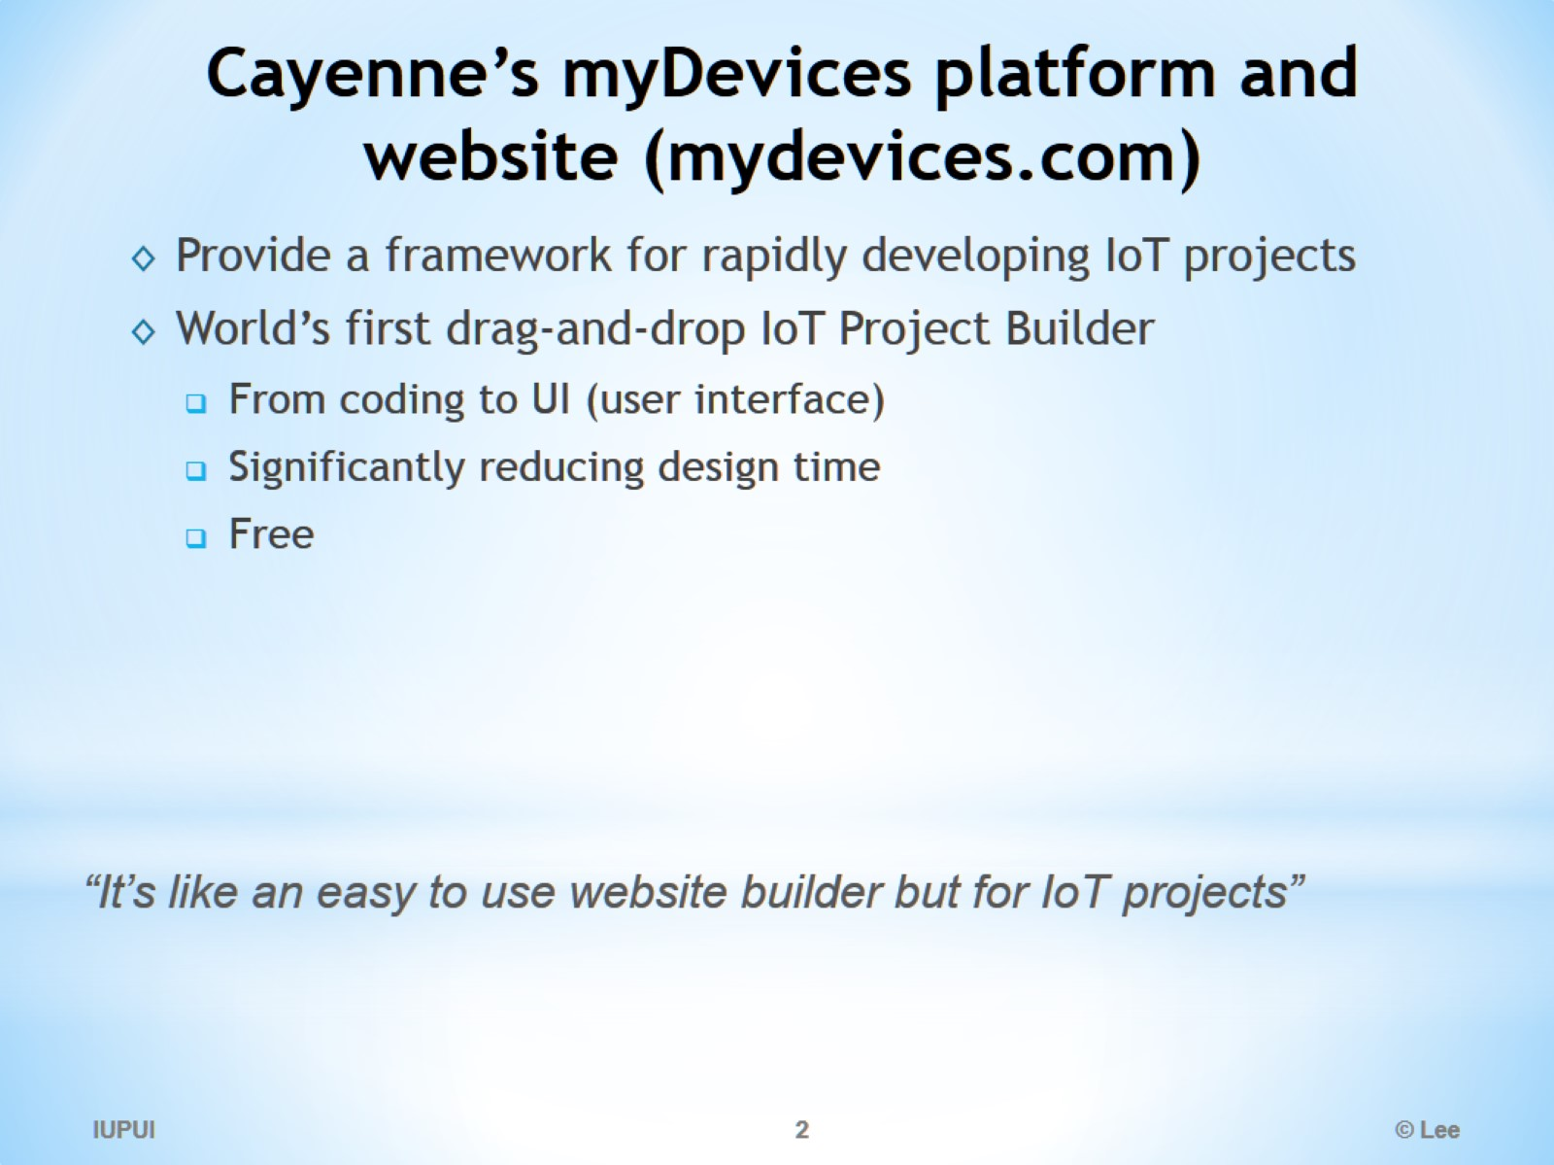
Cayenne’s myDevices platform and website (mydevices.com)

Slide 3
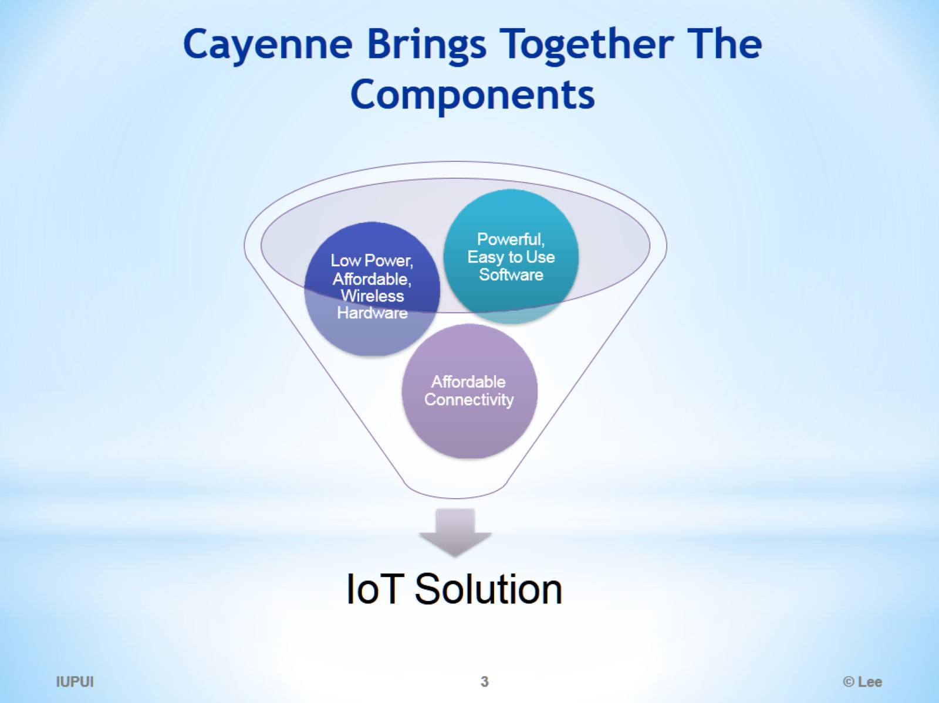
Cayenne Brings Together The Components

Slide 4
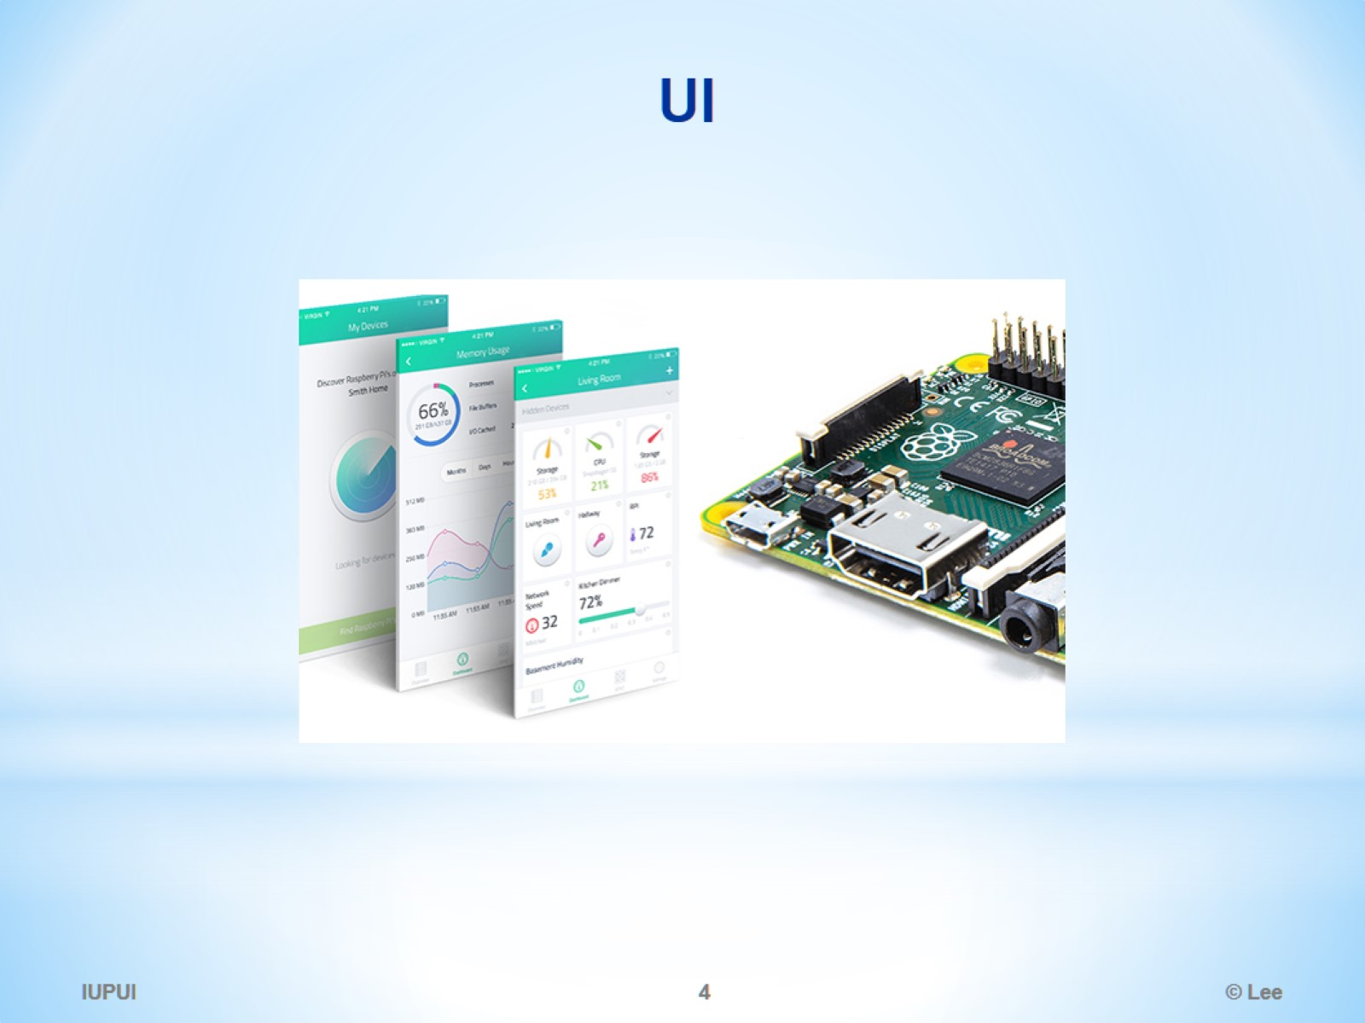
UI

Slide 5

Cayenne Features Overview

Slide 6
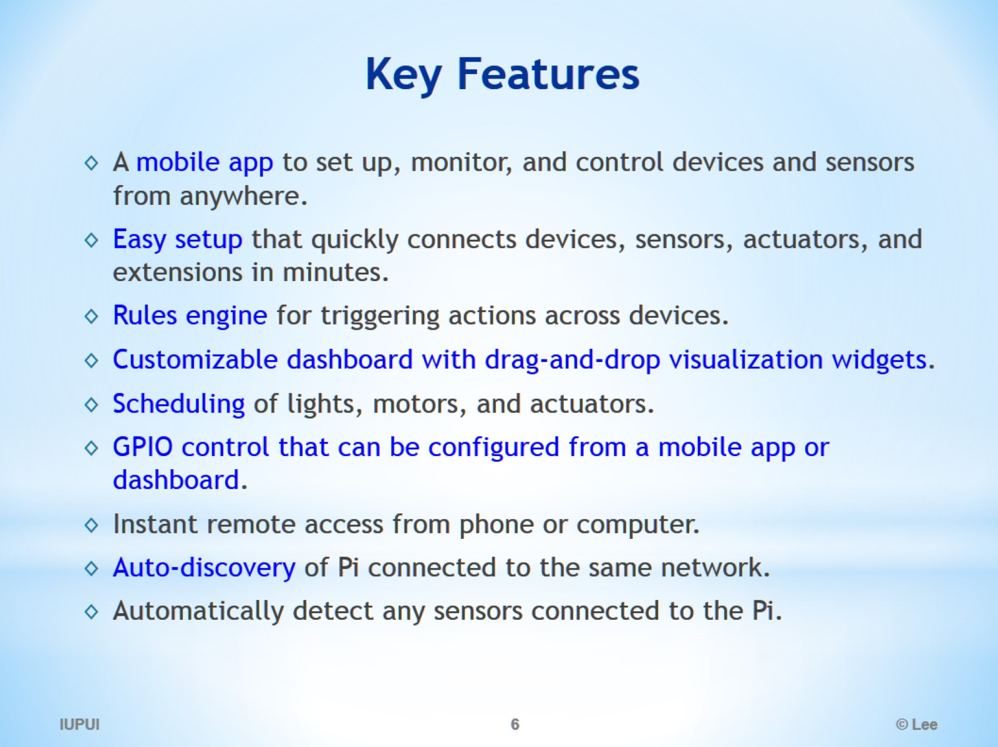
Key Features

Slide 7
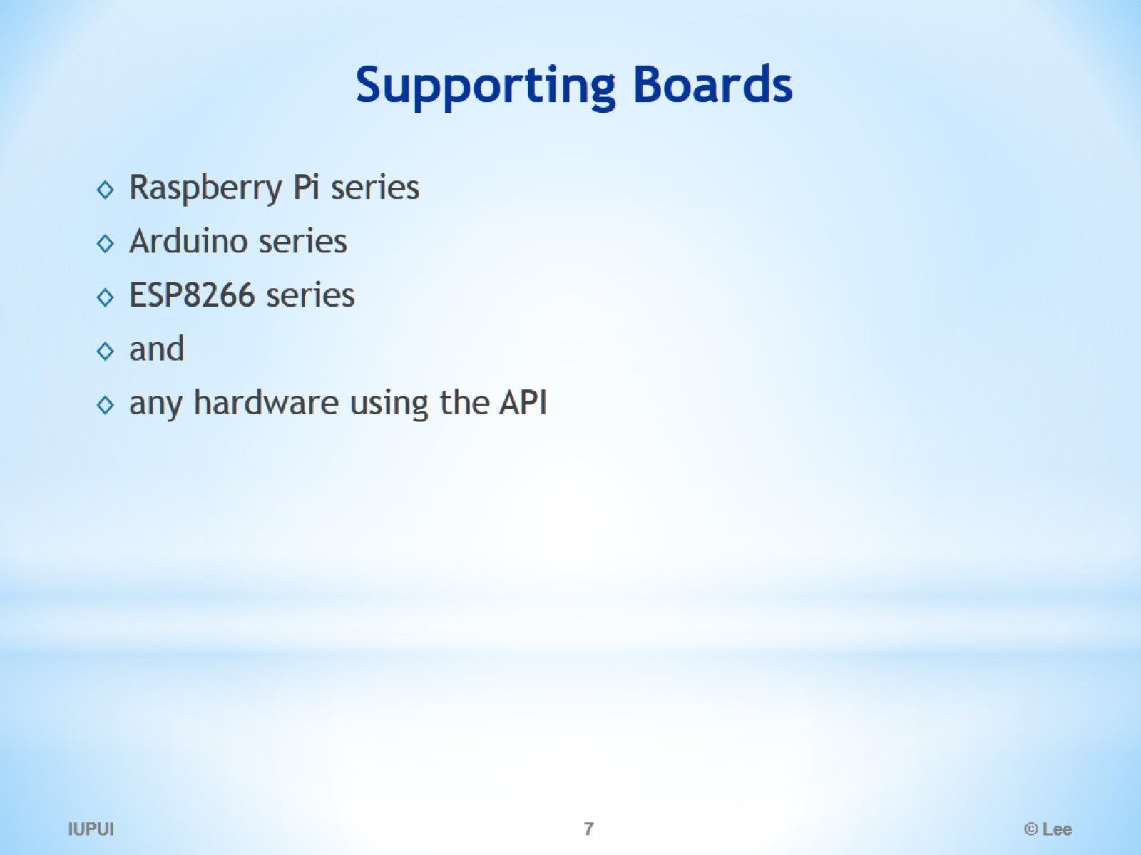
Supporting Boards

Slide 8
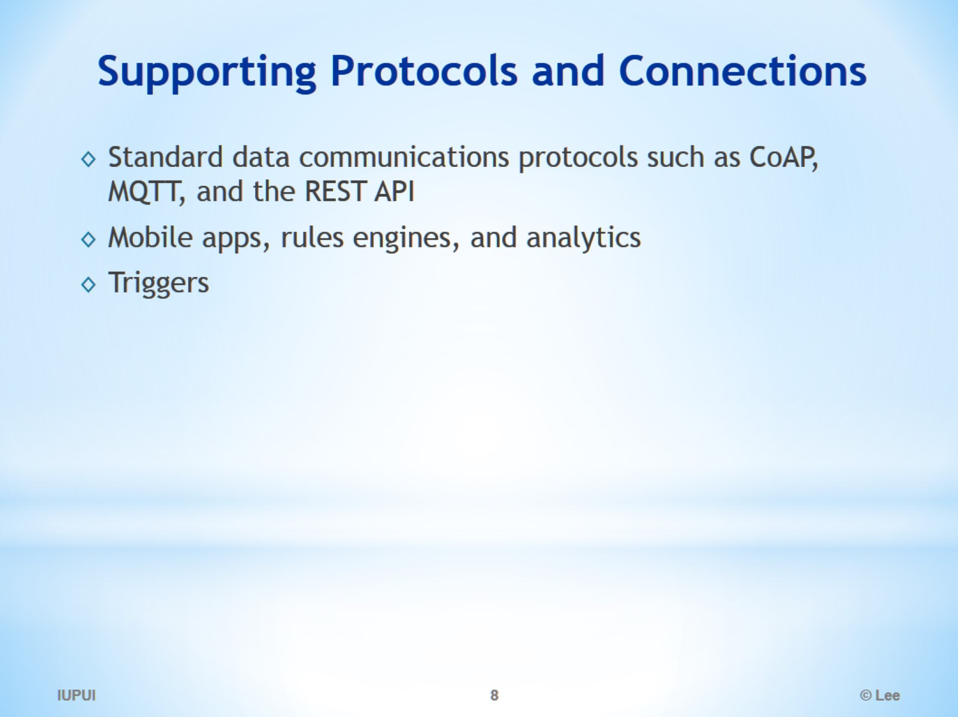
Supporting Protocols and Connections

Slide 9
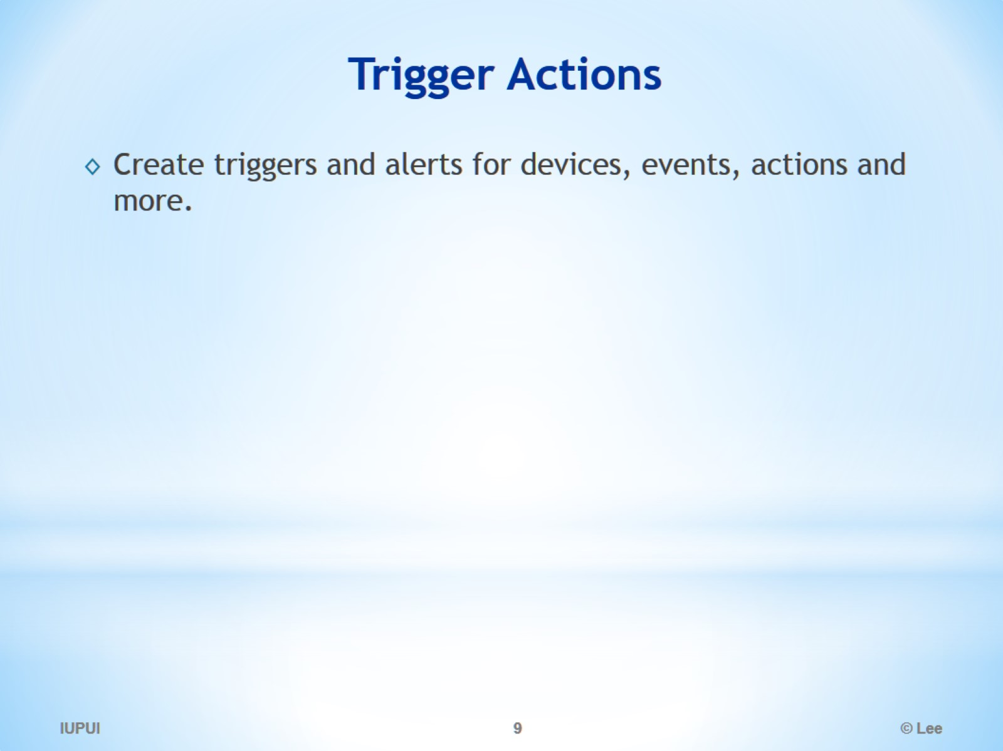
Trigger Actions

Slide 10
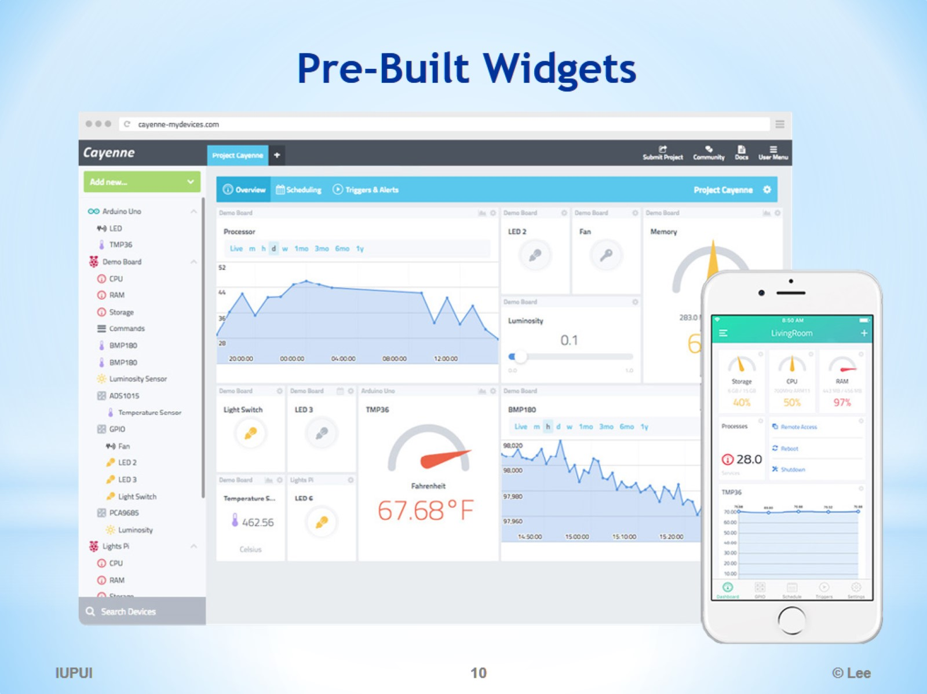
Pre-Built Widgets

Slide 11
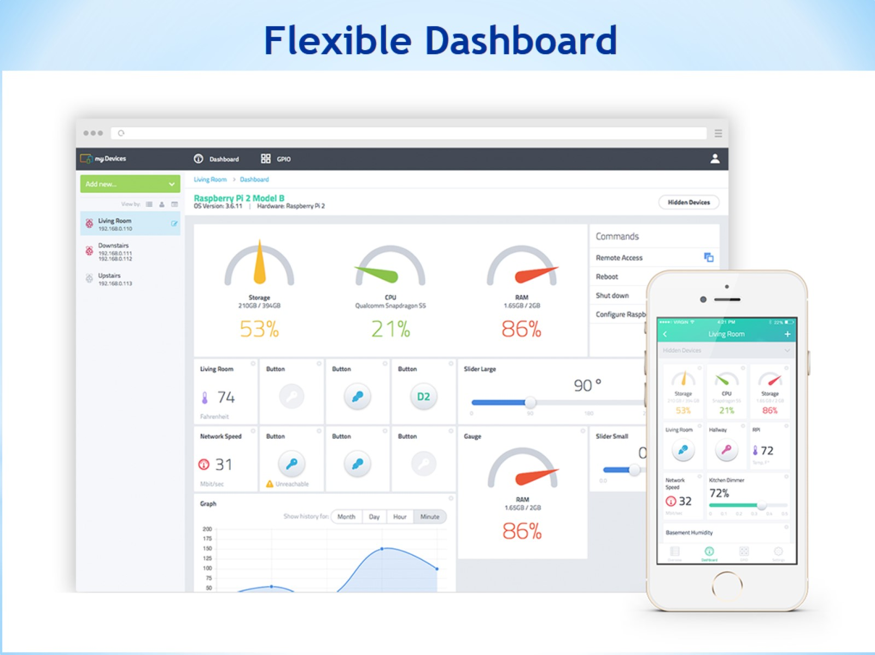
Flexible Dashboard

Slide 12
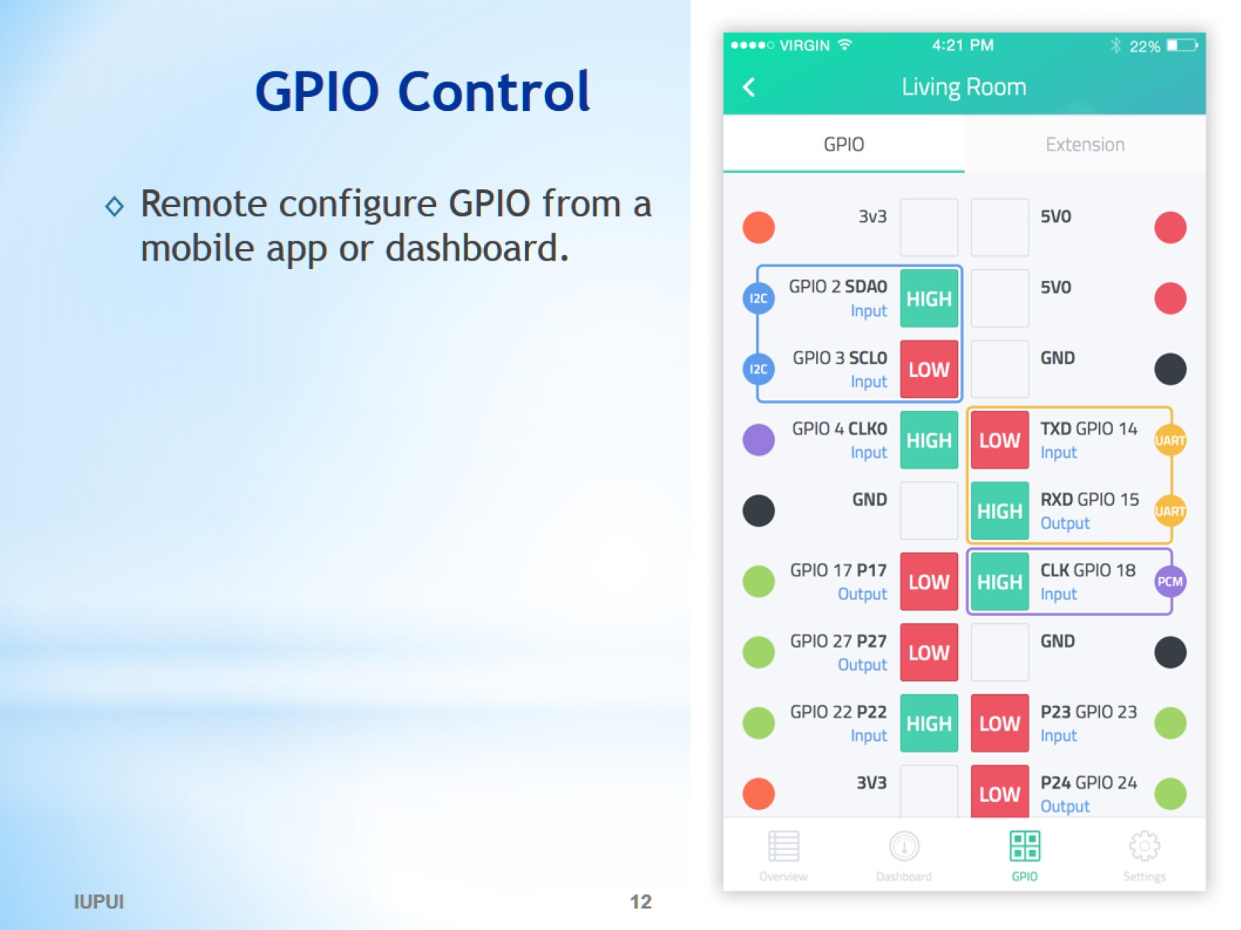
GPIO Control

Slide 13
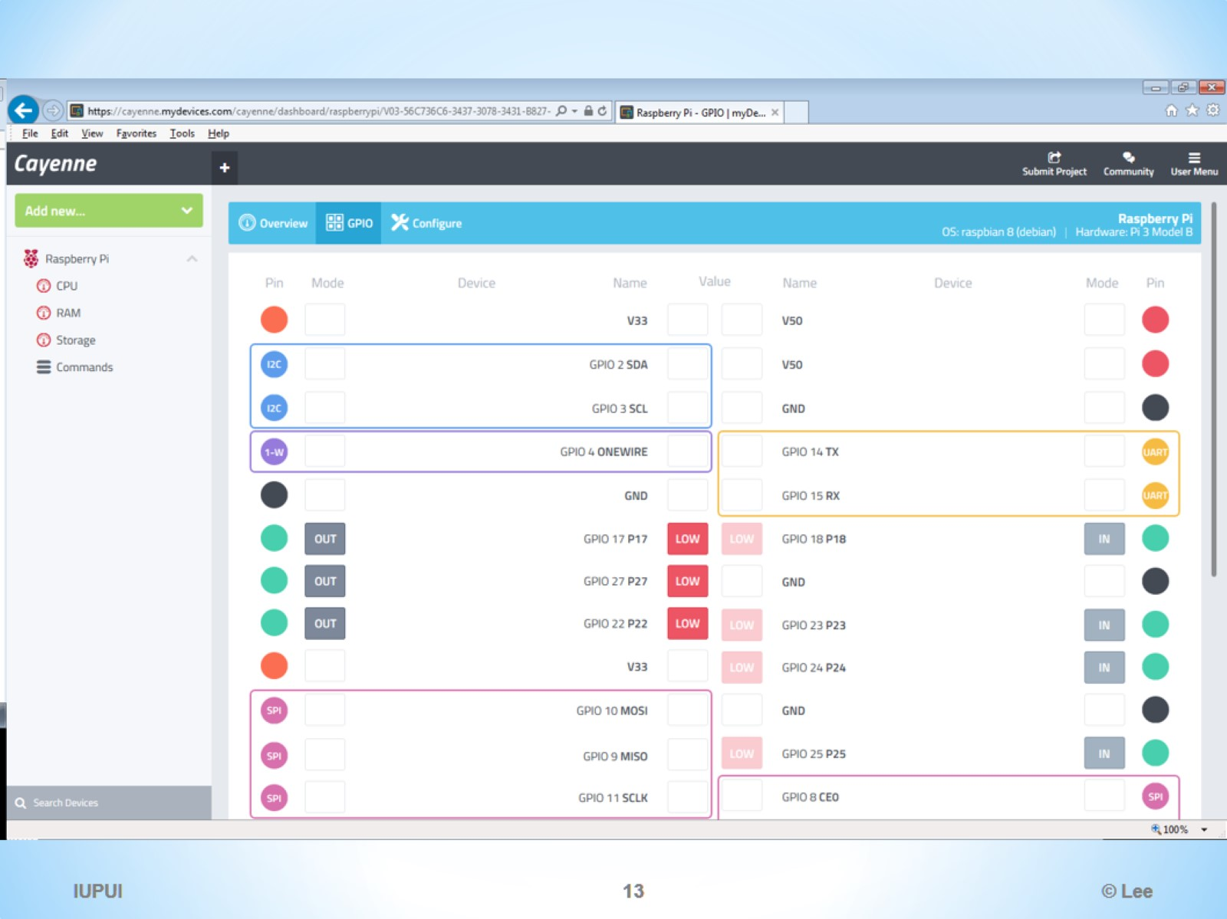

Slide 14
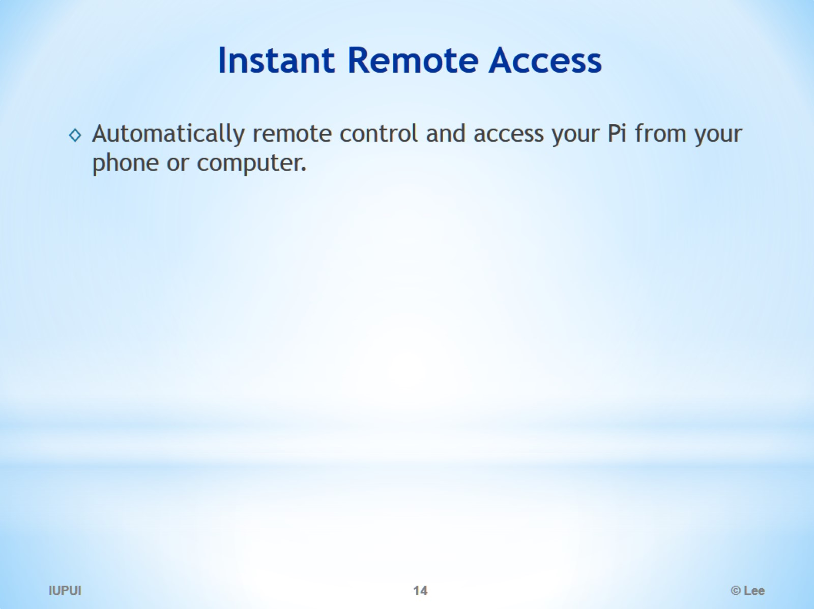
Instant Remote Access

Slide 15
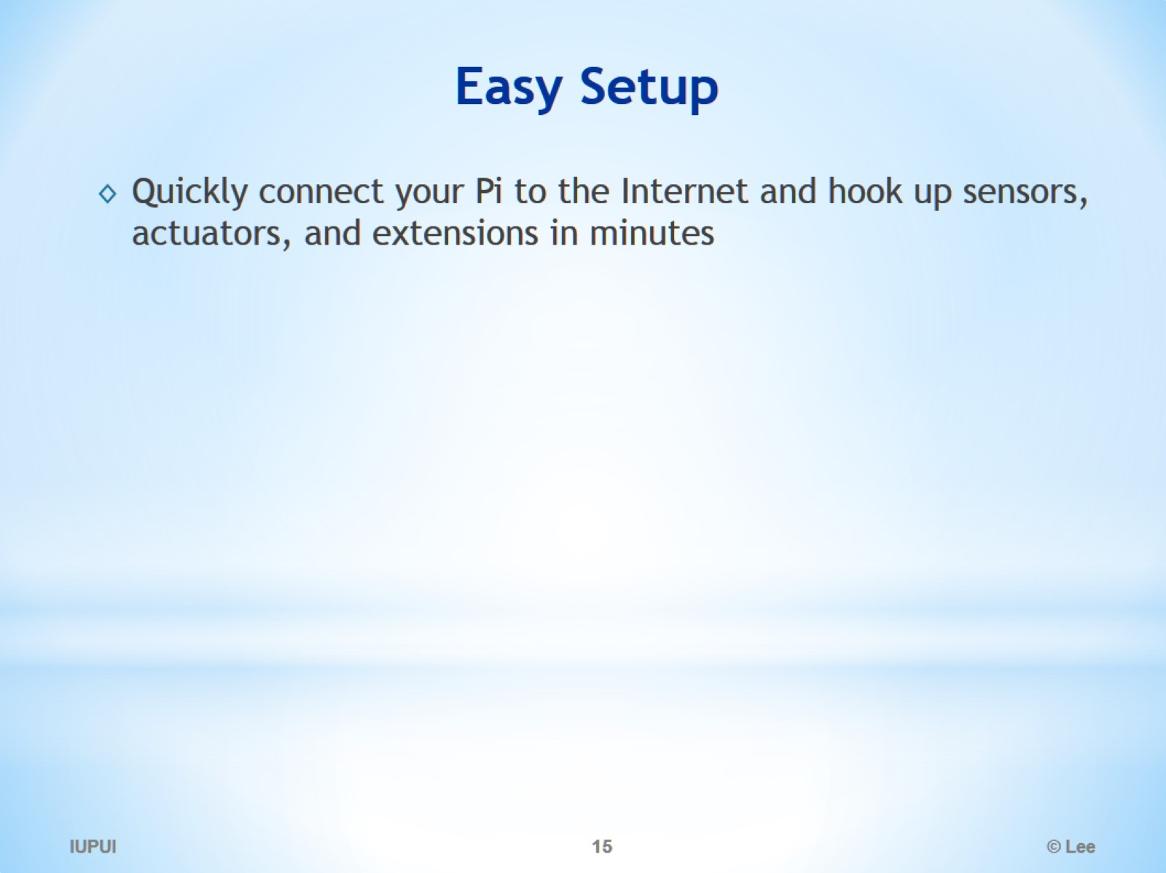
Easy Setup

Slide 16
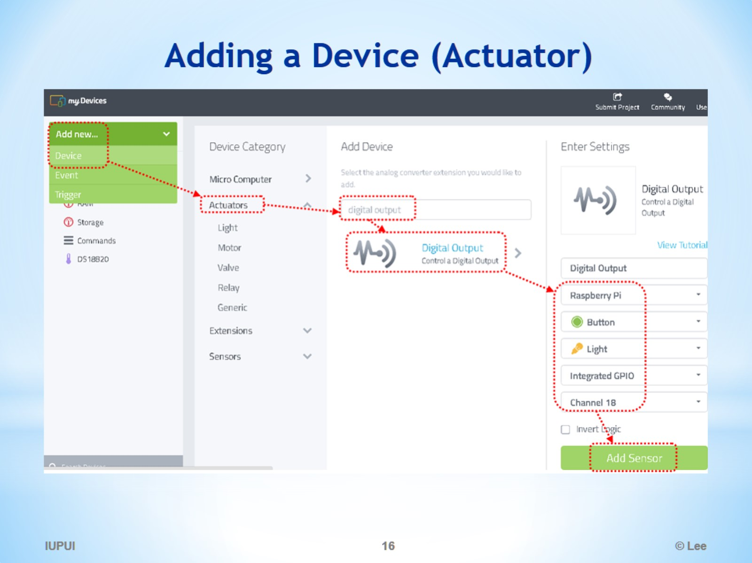
Adding a Device (Actuator)

Slide 17
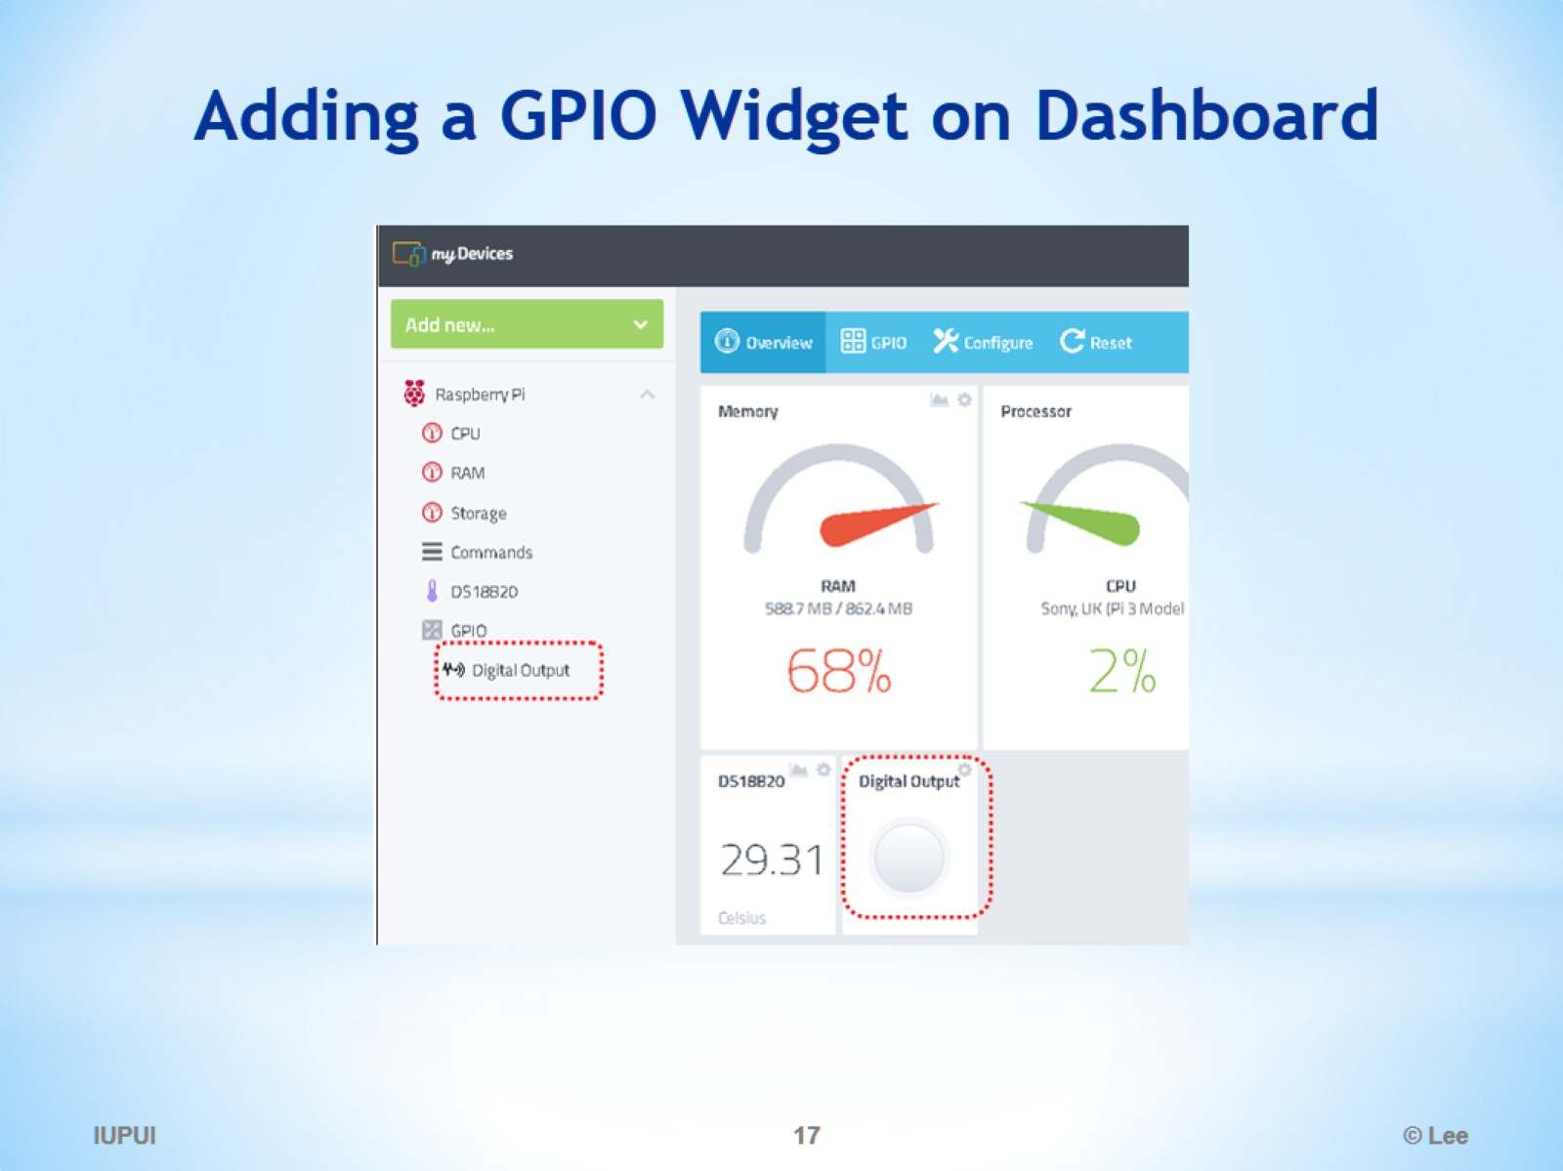
Adding a GPIO Widget on Dashboard

Slide 18
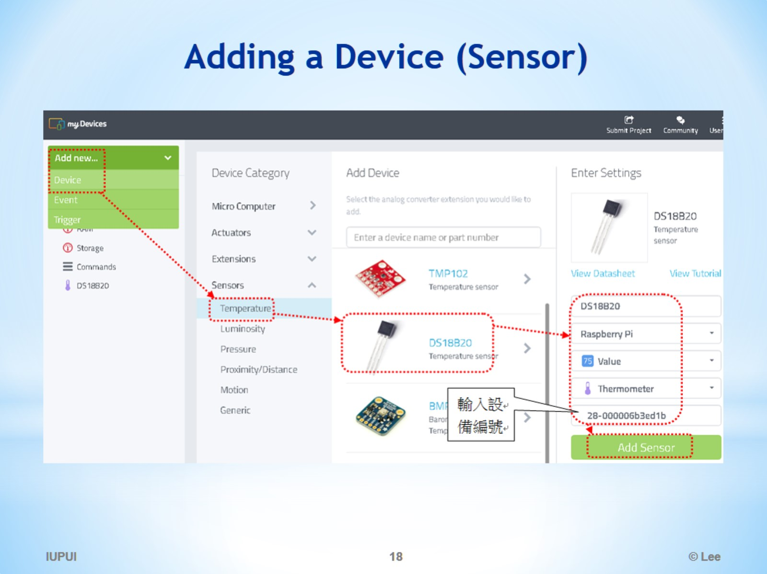
Adding a Device (Sensor)

Slide 19
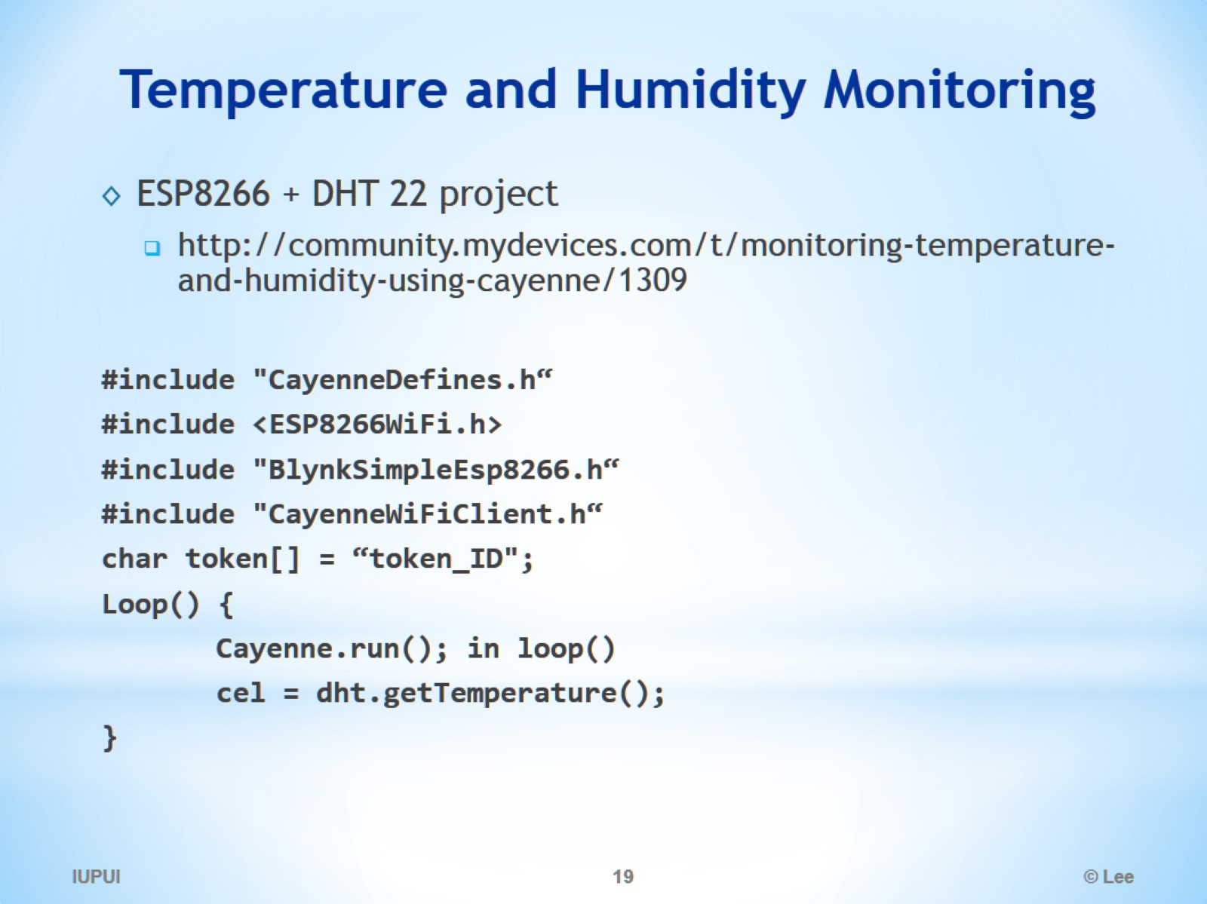
Temperature and Humidity Monitoring

Slide 20
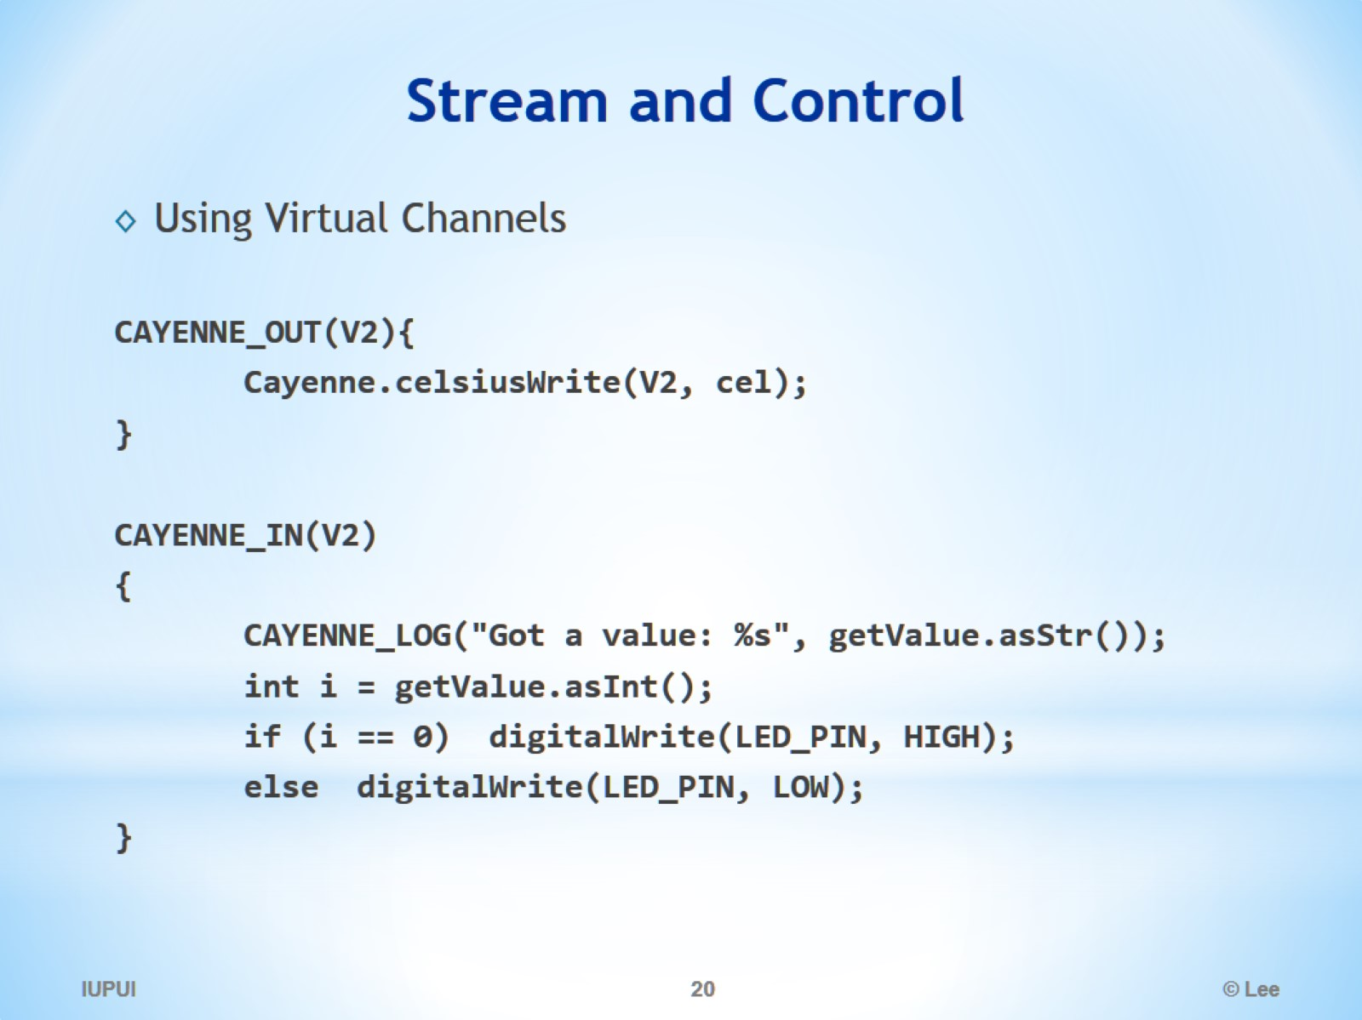
Stream and Control

Slide 21
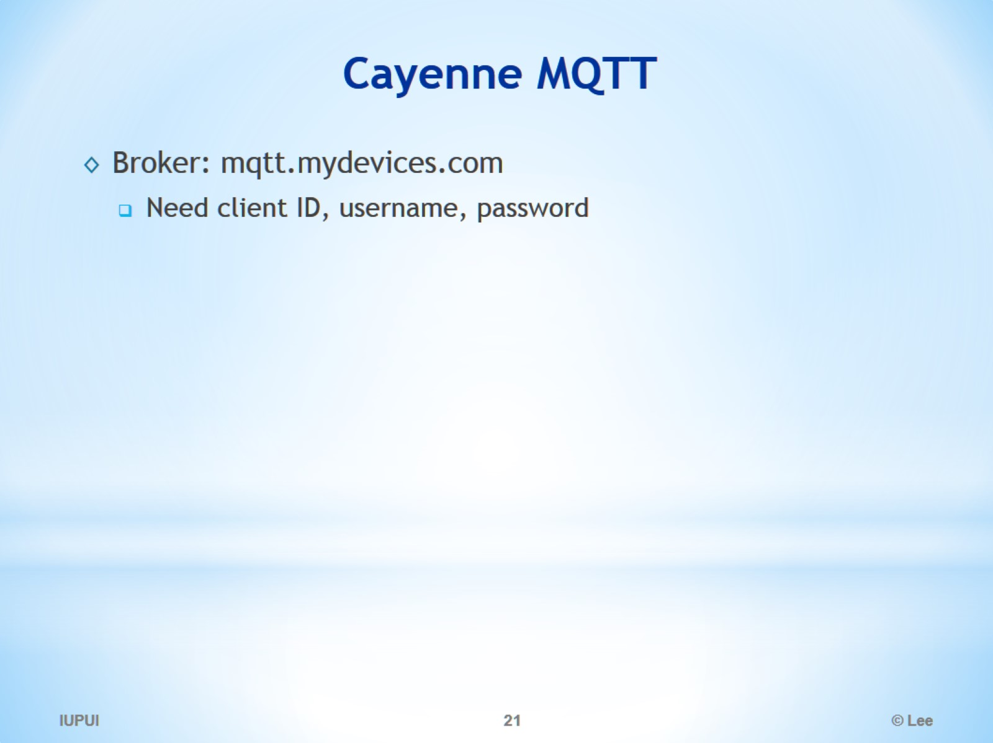
Cayenne MQTT

